Slide 1
ICT Fundamentals
Lecture 5
Data Communication and Computer Network

Slide 2
Computer Networks
A Computer Network is a network of geographically distributed multiple computers connected in a manner to enable meaningful transmission and exchange of information among them.
  OR
Network is a set of devices (nodes) connected through links.
Objectives of Computer Networks
  Sharing of information, sharing of resources ( hardware and software), and sharing of processing load are some of the major objectives of a computer network.

Slide 3
Applications of Networks
Resource Sharing
  Hardware (computing resources, disks, printers)
  Software (application software)
Information Sharing
  Easy accessibility from anywhere (files, databases)
  Search Capability (WWW)
Communication
  Email
  Message broadcast
Remote computing
Distributed processing (GRID Computing)

Slide 4

Applications
Introduction to Computer Networks
E-mail
Searchable Data (Web Sites)
News Groups
Internet Telephony (VoIP)
Video Conferencing
Chat Groups
Instant Messengers
Internet Radio

Slide 5
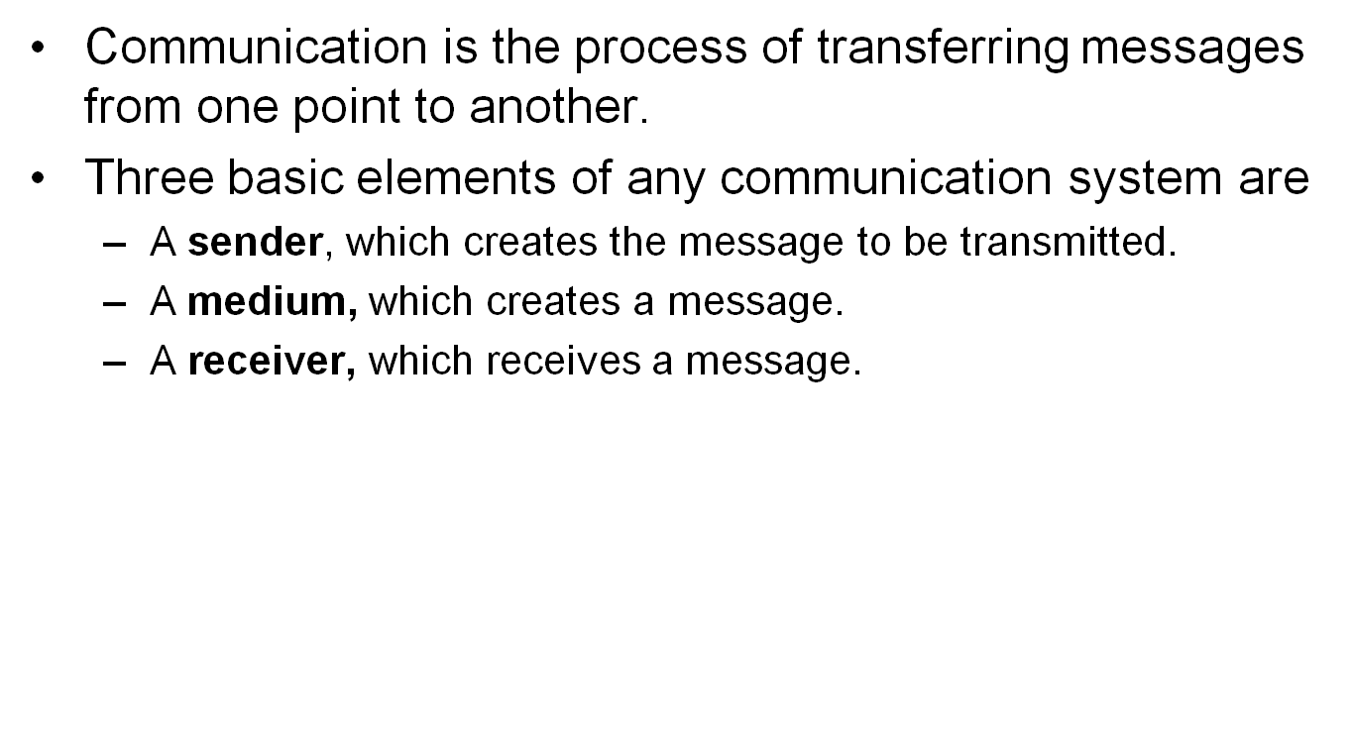
Basic Elements of a Communication System
Sender
Receiver
Medium

Slide 6
Data Transmission Modes
There are three ways, or modes, of transmitting data from one point to another.
  Simplex
  Half duplex
  Full duplex

Slide 7
Data Transmission Modes
Simplex
  In this Transmission mode, communication take place in only one direction.
  Simplex circuits are seldom used because a return path is generally needed to send acknowledgement, error signals.
  Example
    Printer (receive only mode)
Sender
Receiver
Simplex

Slide 8
Data Transmission Modes
Half Duplex
  In this Transmission mode, system can transmit data in both directions, but only in one direction at a time. Hence, a half duplex line can alternately send and receive data.
Sender
Receiver
OR
Half duplex

Slide 9
Data Transmission Modes
Full Duplex
  Full Duplex system allows information to flow simultaneously in both direction on a transmission path.
Sender
Receiver
AND
Full duplex

Slide 10
TRANSMISSION MEDIA

Slide 11
Data Transmission Media
Transmission medium
  Physical path between transmitter and receiver
  May be guided (wired) or unguided (wireless)
Some of the common data transmission media are listed below.
  Twisted Pair Wire
  Coaxial Cable
  Microwave System
  Communication Satellite
  Optical Fibers

Slide 12
Twisted Pair
Least expensive and most widely used
Physical description
  Two insulated copper wires arranged in regular spiral pattern
  Number of pairs are bundled together in a cable
  Twisting decreases the crosstalk interference between adjacent pairs in the cable.
Applications
  Most common transmission media for both digital and analog signals
  Less expensive compared to coaxial cable or optical fiber
  Limited in terms of data rate and distance

Slide 13
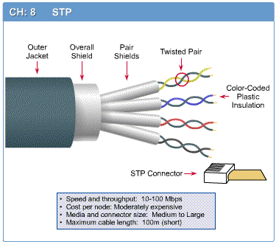
Twisted Pair Types
Unshielded and shielded twisted pairs
  Unshielded twisted pair (UTP)
  Ordinary telephone wire
  Subject to external electromagnetic
  interference
Shielded twisted pair (STP)
  Shielded with a metallic case/paper
  Reduces interference
  Better performance at higher data rates
  More expensive and difficult to work
  compared to UTP

Slide 14
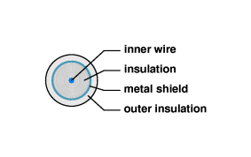
Coaxial Cable
Physical description
  The coaxial cable provides better protection from interference by providing a metal shield.
  The metal shield forms a flexible cylinder around the inner wire providing a barrier to electromagnetic radiation, both incoming and outgoing.
  Outer conductor covered with a jacket or shield
  Shielded concentric construction reduces interference and crosstalk
  Can be used over longer distances and support more stations on a shared line than twisted pair
Applications
  Most common use is in cable TV
  Traditionally part of long distance
  telephone network

Slide 15
Microwave System
Microwave system uses very high frequency radio signals to transmit data through air.
At microwave frequencies, the electromagnetic waves cannot bend or pass obstacles like hill.
So, the transmitter and receiver of microwave system, which are mounted on very high towers, should be in line of sight.
To over come the problem of line-of-sight, microwave systems use repeaters at intervals of about 25 to 30 KMs in between the transmitting and receiving stations.
Microwave system permit transmission rates of about 16 Giga bits per second.

Slide 16
Communication Satellite
Communication satellite is a microwave relay station between two or more ground stations (also called earth stations)
Satellite uses different frequency bands for incoming (uplink) and outgoing (downlink) data.
A single satellite can operate on a number of frequency bands, known as transponder channels or transponders
Satellites are precisely positioned at 36,000 KMs above the surface of the earth with an orbit speed , which is equivalent to rotation speed of the earth.

Slide 17
Optical Fibers
Optical fibers are hair-thin threads of glass, which can serve as a data transmission medium as copper wire.
The basic difference is that optical fiber transmit light signals instead of electrical signals.
As light travels much faster than electricity, optical fibers can transmit data at much higher rate than copper wires.

Slide 18
Optical Fiber
Optical Fiber consist of three concentric Layers
1. Core
  Innermost section of the fiber
  Has a diameter of 8 to 200 micrometers.
2. Cladding
  Surrounds each strand
  Plastic or glass coating with optical properties different from core
  Interface between core and cladding prevents light from escaping the core
3. Jacket
  Outermost layer, surrounding one or more claddings
  Made of plastic and other materials
  Protects from environmental elements like moisture, and crushing

Slide 19
Advantages of Optical Fiber
Large Bandwidth
Low Loss
Immunity to electromagnetic interference.
Small size and lightweight.
Security
Analog and digital signals transmission.

Slide 20
Types of Connection
To make the communication possible, two devices must be connected,
  in some way to the same link at the same time
There are two possible types of connection
  Point-to-point
  Multipoint

Slide 21
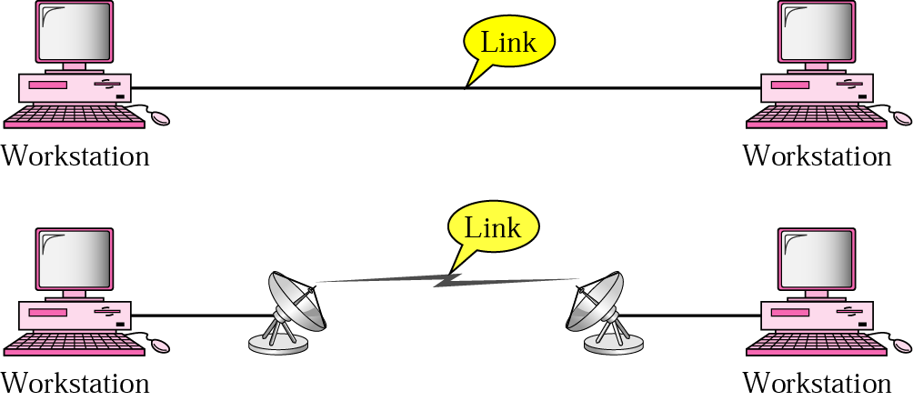
Point-to-point connection
Provides a dedicated link between two devices
Entire capacity of the link is reserved for transmission between these two devices
Point to point communication not usually practical
  Devices are too far apart
  Large set of devices would need impractical number of connections

Slide 22
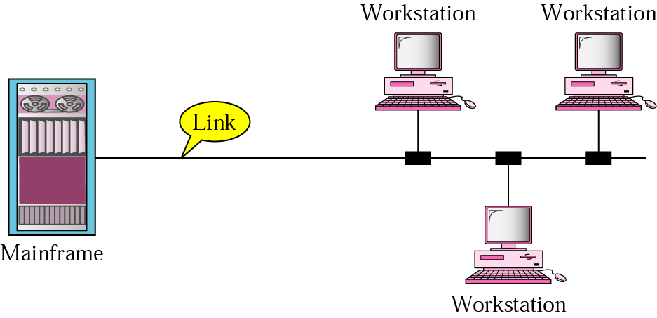
Multipoint connection
More than two specific devices share a single link
The capacity of the channel is shared between the users

Slide 23
NETWORK TOPOLOGY

Slide 24
Network Topology
The term refers to the way in which a network is laid out physically
  Two or more devices connect to a link- two or more links form a topology
  The topology of a network is a geometric representation of the relationship of all the links and linking devices
Four basic topologies are possible:
  Mesh
  Star
  Bus
  Ring

Slide 25
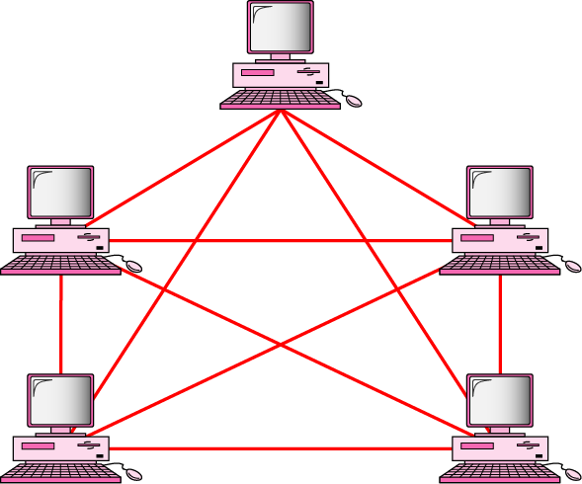
Fully connected mesh topology
Every device has a dedicated point-to-point link to every other device
Dedicated link carries the traffic only between two connected devices
Advantages:
  Each data or link will carry its own data load, no traffic problem
  Provide privacy and security
  One link break down only affect the
  communication between the connected computers
  Fault tracing and isolation
Disadvantage
  More cabling is required

Slide 26
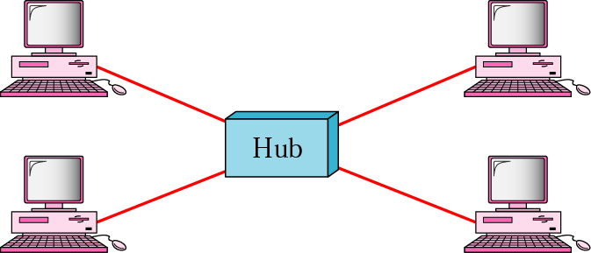
Star topology
Each device has a dedicated point-to-point link, only to a central controller “ hub”
Devices are not directly connected to each other
It does not allow direct traffic between devices, it is through controller
Advantage:
  Less expensive, only one link is required
  Transmission delays between two nodes do not increase by adding new nodes to the network.
  Fault location and isolation easy
  If any computer fails, the remaining portion of the network is unaffected.
Disadvantage:
  Communication is dependent on central node

Slide 27
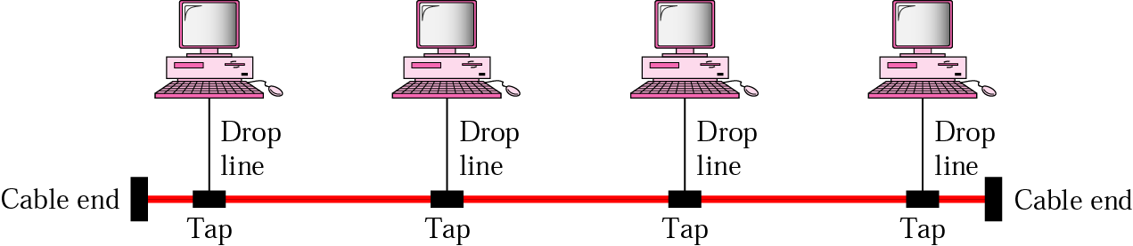
Bus topology
This topology falls under multipoint,
One long cable act as backbone links all other devices
Limited number of devices can be connected and work for a shorter distance (signal become weak over distance)
Advantage:
  Less cabling only the backbone cable runs across the length
Disadvantage
  Difficult reconnection and fault tracing
  If the communication line fails, the entire system breaks down.

Slide 28
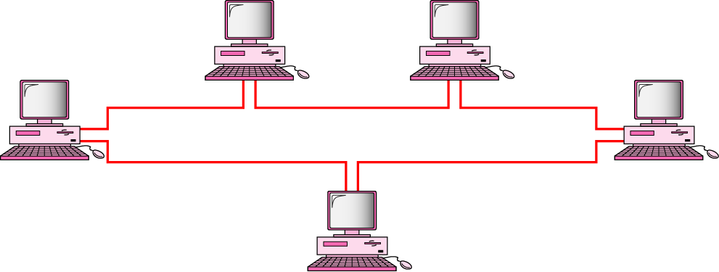
Ring topology
Each device has a dedicated point-to point connection only with the two devices on either side of it
Signal is passed along the ring in one direction, from device to device till it find the destination
Advantage
  Easy to install and reconfigure
  To add or remove a device requires only two connection to change
Disadvantage
  Unidirectional traffic
  In a ring network, communication delay is directly proportional to the number of nodes in the network. Hence Addition of new nodes in the network increases the communication delay.
  Breaking a ring disable communication

Slide 29
NETWORK TYPES

Slide 30
Common Network Types
Local Area Network (LAN)
  Contains printers, servers and computers
  Systems are close to each other
  Contained in one office or building
  Organizations often have several LANS
Wide Area Networks (WAN)
  Two or more LANs connected
  Over a large geographic area
  Typically use public or leased lines
    Phone lines
    Satellite

Slide 31
Hybrid Network Types
Campus Area Networks (CAN)
  A LAN in one large geographic area
  Resources related to the same organization
  Each department shares the LAN
Metropolitan Area Network (MAN)
  Large network that connects different organizations
  Shares regional resources
  A network provider sells time

Slide 32
Hybrid Network Types
Home Area Network (HAN)
  Small scale network
  Connects computers and entertainment appliances
  Found mainly in the home
Personal Area Network (PAN)
  Very small scale network
  Range is less than 2 meters
  Cell phones, PDAs, MP3 players

Slide 33
OSI REFERENCE MODEL

Slide 34
The OSI Model
The initial computer networks had their own set of standard and convention that were hardware oriented.
Each manufacturer used to develop its own communication protocols for its own network.
Hence the data communication protocols of one network were not compatible with any other network.
The problem was recognized by the International Standard Organization (ISO), which established a subcommittee to develop an international standard on Network Architecture.
Open System Architecture (OSI) model was the result of that committee.

Slide 35
The OSI Model
The standardized OSI protocols made it possible for any two heterogeneous computer system, located anywhere in the world, to easily communicate with each other.
The OSI model is also designed in a highly structured way. It is a seven layer architecture in which a separate set of protocols is defined for each layer.
Each layer has an independent function and deals with one or more specific aspects of communication.

Slide 36
OSI Model
The seven Layer of OSI model are
7. Application Layer
6. Presentation Layer
5. Session Layer
4. Transport Layer
3. Network Layer
2. Data Link Layer
1. Physical Layer

Slide 37
Physical Layer
Physical layer is responsible for transmitting raw bits streams between two nodes.
It converts the sequence of binary bits into electrical signals, light signals, or electromagnetic signals, depending on the transmission medium.
Physical layer also decides whether transmission can take place only in one direction or in both direction.
The Physical layer also deals with the mechanical details, such as the size and shape of the connecting plugs, the number of pins in the plugs, and the function of each pin.

Slide 38
Data link Layer
It is the responsibility of data link layer to detect and correct any errors in the transmitted data.
Since the physical layer is concerned with the bit stream, the data link layer partitions it into frames, so that error detection and correction can be performed independently on each frame.
The data-link layer also perform the flow control of frames between two sites to ensure that a sender does not overwhelm a receiver by sending frames at a rate faster than the receiver can process.

Slide 39
Network Layer
The network Layer is responsible for setting up a logical path between two nodes for communication to take place.
The network layer responsibility is to identify the path, using a high level addressing and routing scheme, to transmit packets from one node to another.
Routing is the primary job of the network layer, and routing algorithms forms the main part of the network layer protocols.

Slide 40
Transport Layer
Transport Layer accepts messages of arbitrary length from the session layer, segments them into packets, submits them to the network layer for transmission, and finally reassembles the packets at the destination.
The transport layer protocols include mechanisms for handling lost and out-of sequence packets.
The transport layer records a sequence number in each packets, and uses the sequence numbers for detecting lost packets and for ensuring that messages are reconstructed in the correct sequence.
Two popular transport layer protocols
  Transport Control Protocol (TCP)
  User Datagram Protocol (UDP)

Slide 41
Session Layer
The session layer provides means of establishing, maintaining and terminating a dialogue or a session between the two end users.
It allows the two parties to authenticate each other before establishing a dialogue session between them.
If the message is a connection request, it initiates a dialogue session.

Slide 42
Presentation Layer
The presentation layer provides facilities to convert message data into a form, which is meaningful to the application layer.
The presentation layer may perform such transformation as encoding and decoding, code conversion, compression and decompression, encryption and decryption, on the message data.

Slide 43
Application Layer
The application layer provides services that directly support the end user of the network.
Example of application layer protocols
  Electronic mail (Email)
  File transfer protocol (FTP)
  Remote login protocol

